Slide 1

Project Title: Customer Segmentation using K-Means
WEBPOISE INTERNSHIP
Aravind V | 1RV22CD011
Likhith A | 1RV22CD027
K Sai Chetan | 1RV23CD404
Vaibhav TL | 1RV22IS075
Anjan Babu KN | 1RV23CD400
Vikas AL | 1RV23CY405

Slide 2
Introduction
Customer segmentation is a key marketing strategy used to identify unique customer groups.
This project applies K-Means clustering on the Mall Customers dataset to categorize customers.
Based on Annual Income and Spending Score.

Slide 3
Objectives
Understand customer characteristics.
Identify meaningful customer clusters.
Use the Elbow Method to determine optimal
cluster count.
Provide business insights to improve decision
making.

Slide 4
Methodology
1. Load and clean dataset
2. Perform exploratory data analysis
3. Apply K-Means clustering
4. Evaluate cluster count using Elbow Method
5. Visualize and interpret customer clusters

Slide 5
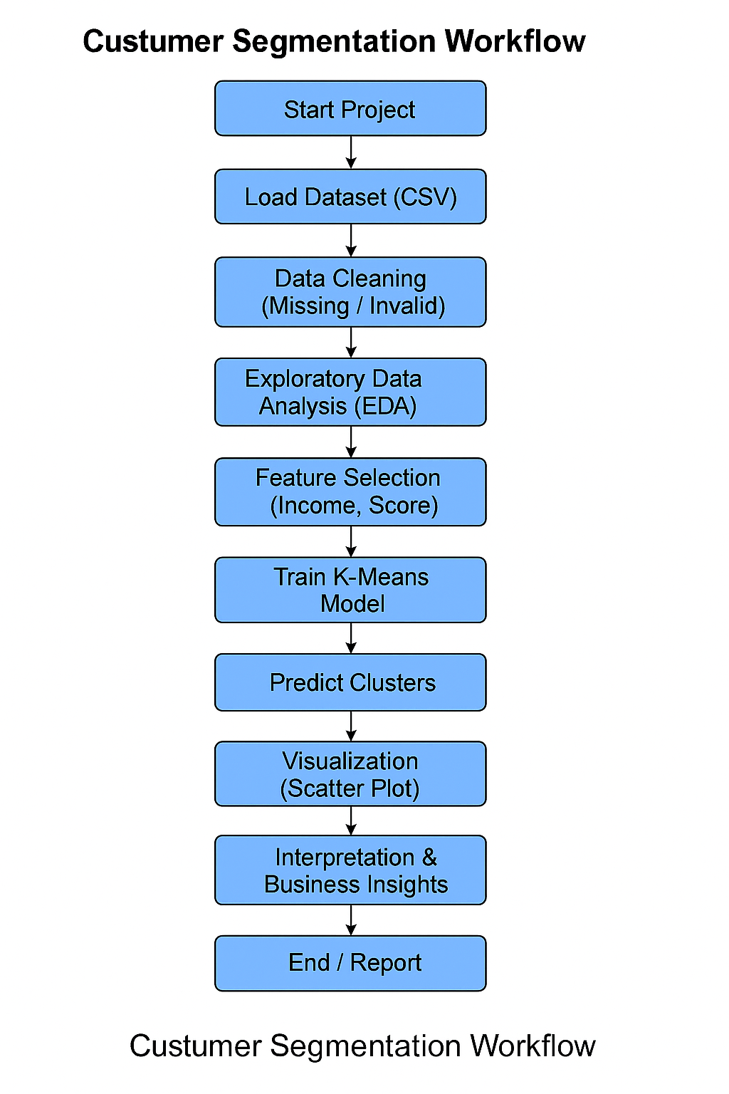
Workflow Diagram

Slide 6
Detailed Process Explanation
Data cleaning removes missing or inconsistent values to ensure accuracy.
Feature analysis helps understand distributions of age, gender, income, and spending score.
K-Means groups customers by minimizing intra-cluster distances.
Elbow Method helps avoid overfitting by selecting optimal K.
Visualizations help businesses quickly identify high-value customer segments.

Slide 7
Results
Dataset prepared and cleaned successfully.
Optimal clusters identified using Elbow Method.
Customer profiles created: High-income high-spending, mid-tier, low-spending groups.
Helps companies target premium customers and personalize offers.

Slide 8
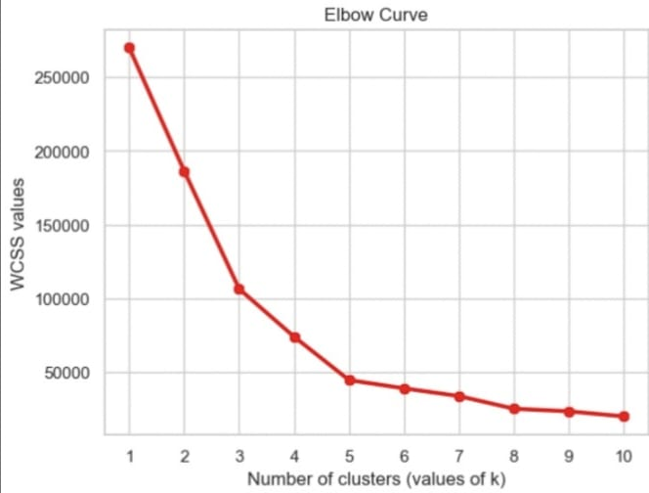
Visuals of Results

Slide 9
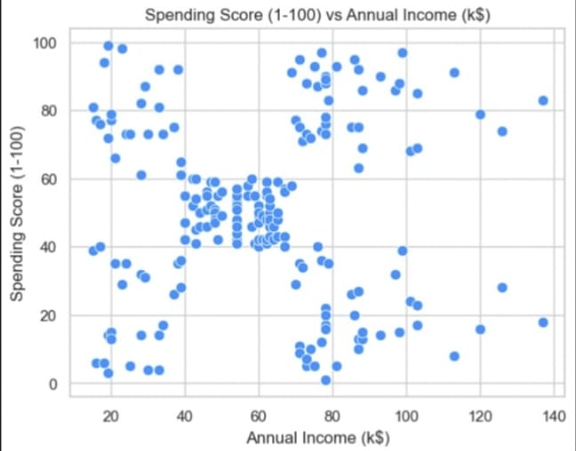
Visuals of Results

Slide 10
Business Insights
High spenders can be targeted with loyalty programs.
Low spenders may need discounts or personalized offers.
High-income low-spending customers are potential growth opportunities.
Segmentation improves ROI for marketing campaigns.

Slide 11
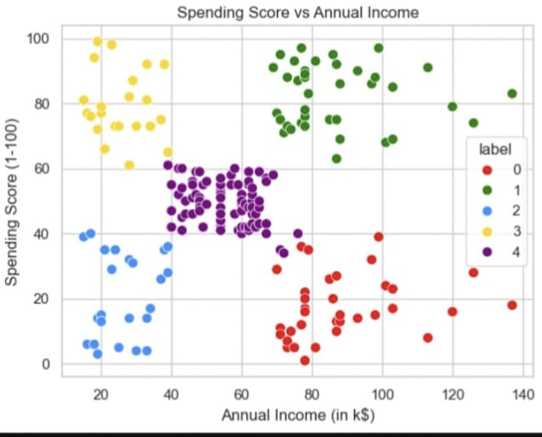
Visuals of Results

Slide 12
Conclusion
Customer segmentation helps businesses understand their audience.
K-Means provides a simple yet effective way to identify meaningful groups.
The insights gained can significantly enhance marketing and sales strategies.

